Slide 1
Instructions
Use Shapes to create an Oreo package. Start by creating a blank package. Mrs. Axtell will project an example of a blank package on the board.
To celebrate Oreo’s birthday, Nabisco has asked YOU to create a new Oreo flavor package. You should focus on promoting the new flavor.
You may still use the Oreo trademarks, colors, slogan, etc., located on the next slide. Remember NOT to replicate old Oreo flavors.

Slide 2
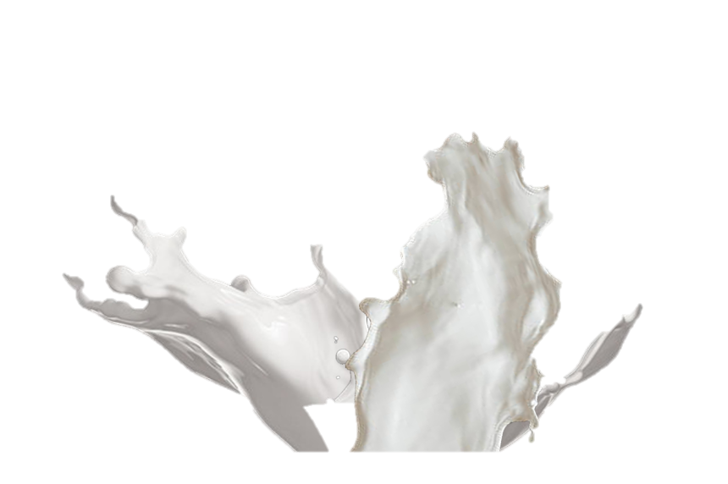
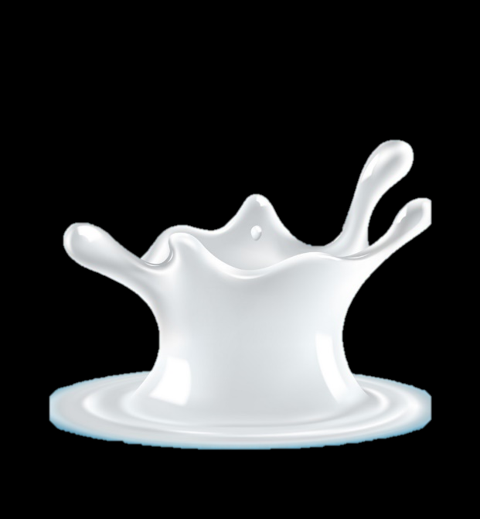
SEALED
SSLIT APPEARS WHEN OPENED

