Slide 1
Excel 1
Microsoft Office 2013

Slide 2
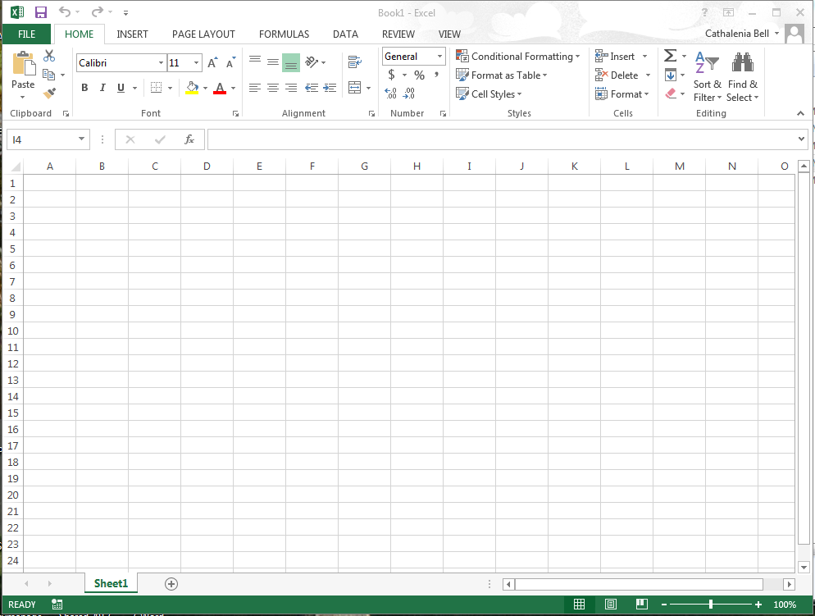
Excel Window
4 Ribbon
2 File Tab
1 Title Bar
3 Top Level Tabs
5. Group
7 Name Box
6 Active Cell
8 Formula Bar
9 Column
10. Row
11 Sheet Tabs
12 View Buttons
Notes:
1

Slide 3
Excel
Spreadsheet applications are used to track, analyze, and chart numeric information
Used for business, industry, education, and by individuals who make financial decisions
Microsoft Excel is an electronic spreadsheet program
The term worksheet refers to electronic spreadsheets
  A collection of worksheets is a workbook
There is 1 default sheet in a workbook

Slide 4
Spreadsheets
The function of a spreadsheet allows you to
  Compile data
  Analyze data
  Perform Calculations
  Create charts

Slide 5
Words to know:
Vertical information labeled A,B,C – COLUMNS
Horizontal areas labeled 1,2,3 – ROWS
Intersection of a column and row – CELL
The cell with the dark rectangle is called the Active Cell
CELL ADDRESS identifies the coordinates of the intersecting column and row
  A1, F10, H233 are examples of cell addresses

Slide 6
Words to know
NAME BOX displays the cell address of the active cell
The ACTIVE CELL and FORMULA BAR displays the data as it is entered
Cells can contain:
  Labels (text)
    By default, all Labels (text) in cells is left aligned
  Values (numbers)
    By default, all Values (numbers) in cells are right aligned
  Formulas or functions
  Dates (serial numbers that can be used included in formuals)
    By default, all Dates (serial numbers) in cells are right aligned
RANGE is a selected group of cells
  The : indicates a range of cells
  B3:D3 is a range of cells
  The range of cells include cells B3 through D3

Slide 7
getting around
Left or Right one cell or up and down one row
TAB will move the active cell to the right
SHIFT + TAB will move the active cell to the left
Home takes you to the beginning of a row
Ctrl+Home takes you to A1

Slide 8
Inputting & Changing Data
Key data directly into active cell
F2 or Double Click to make changes in the cell
CLICK INTO THE FORMULA BAR to make changes
Press the DELETE key or just start keying in new data
You DO NOT have to highlight the data in order to delete or change it.

Slide 9
Know your Pointers
Select
Fill
Move

Slide 10
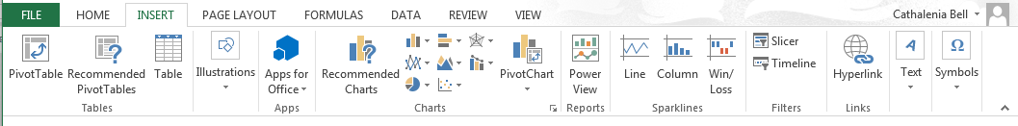
Headers & Footers
Insert Tab > Text Group, Header & Footer button
Header
  Left – Name
  Center – Insert File Name
  Right – Class Period
Footer
  Left– Insert Date
  Middle-Insert Sheet Name
  Right– Teacher’s Name
Always change back to normal view after inserting headers/footers

Slide 11
Be sure to save & Print
Excel files save with an .xlsx file extension
You can view worksheets in two ways
View in
  Regular view – displays the values
  Formula view – displays the formulas
  Ctrl + ` will toggle you between regular view and formula view (Key above Tab Key) or go to Formulas →View Formulas

Slide 12
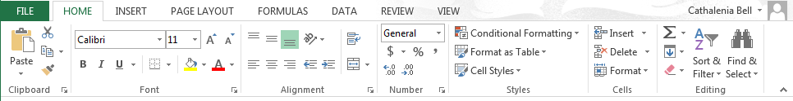
Useful Ribbons
Font
BOLD
Italic
Underline
Increase Font Size
Decrease Font Size
Borders
Fill Color
Font Color
Alignment
Horizontal
Left Align
Center Align
Right Align
Vertical
Top Align
Middle Align
Bottom Align
Wrap Text
Increase/Decrease Indent
Merge & Center
Orientation
Number
Accounting Number Format
Percent Style
Comma Style
Increase/Decrease Decimal
Styles
Conditional Formatting
Format as Table
Cell Styles
Cells
Insert and Delete Columns and Rows
Format
Editing
AutoSum
Fill
Clear
Sort & Filter
Find & Select
To manually wrap text—Alt + Enter

Slide 13
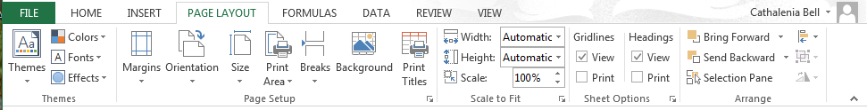
Printing & Page Set-Up
Themes
Page Setup
Margins
Orientation
Print Area
Print Titles
Scale to Fit
Automatic Width
Automatic Height
Sheet Options
Print & View Gridlines
Print & View Headings

Slide 14
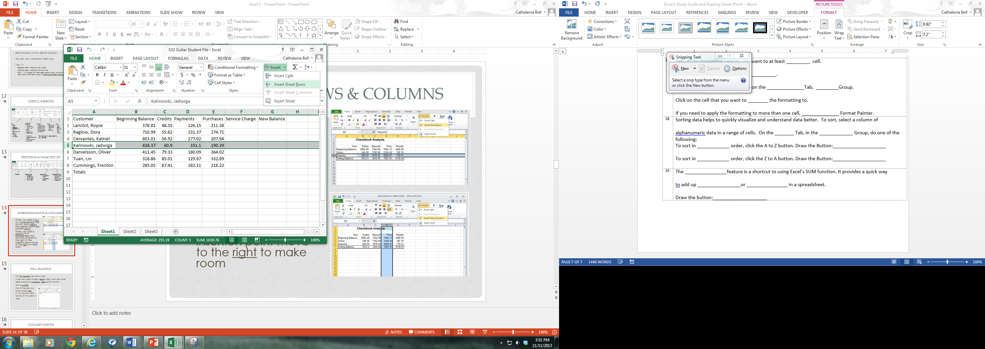
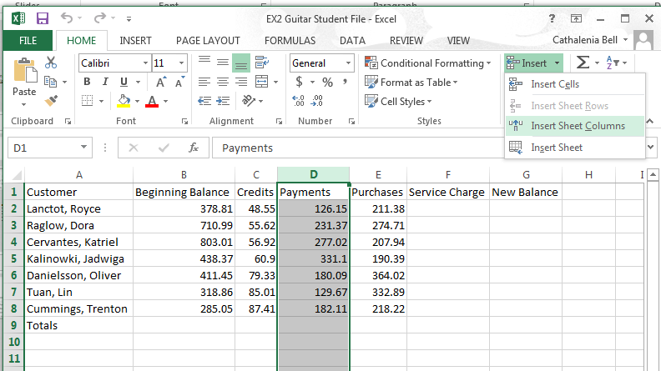
Inserting Rows & Columns
When you add a row to a spreadsheet, the rows of data below the insertion point are pushed down
When you add a column to a spreadsheet, the columns of data to the right of the insertion point move to the right to make room

Slide 15
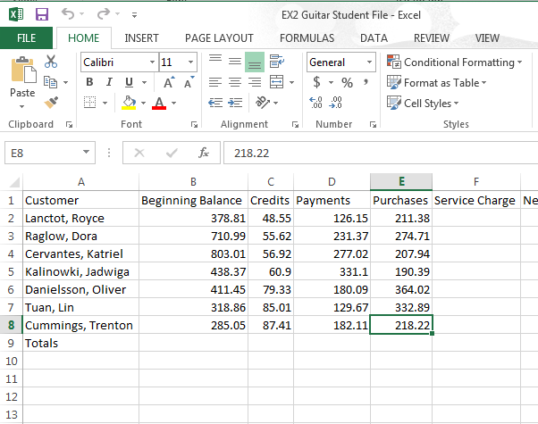
Fill Handle
The Fill Handle has many uses
It can be used to copy data, copy formulas, and add a series of numbers, days and months
This is AutoFill
The Fill Handle is a
small, green dot
in the bottom right
corner of the active
cell

Slide 16
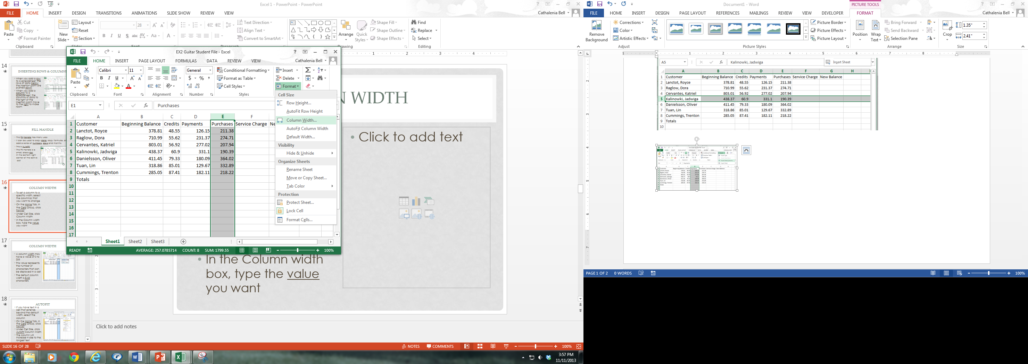
Column Width
To set a column to a specific width, select the column(s) that you want to change
On the Home Tab, in the Cells Group, click Format
Under Cell Size, click Column Width
In the Column width box, type the value you want

Slide 17
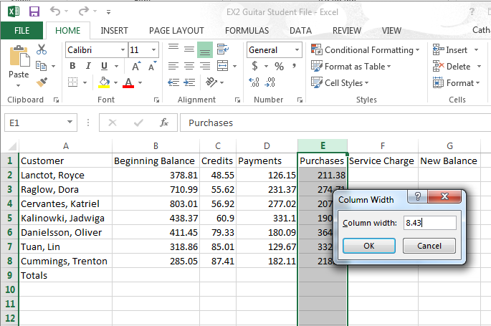
Column Width
A column width may have a value of 0 to 255
This value represents the number of characters that can be displayed in a cell
The default column width is 8.43 characters

Slide 18
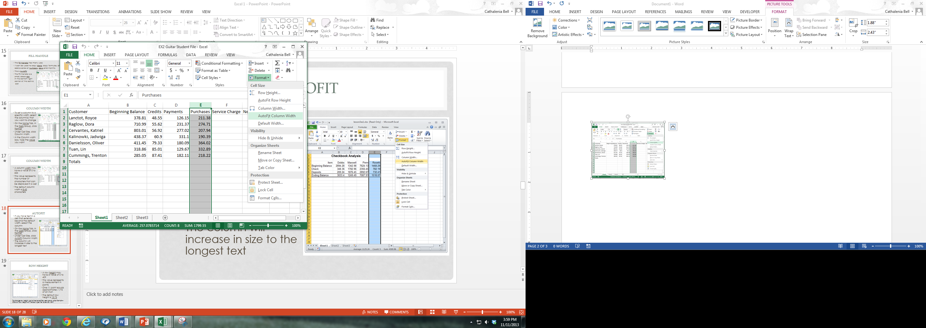
AutoFit
If you have text in a cell that extends beyond the default width, select the column
On the Home Tab, in the Cells Group, click Format
Under Cell Size, click AutoFit Column Width
The column will increase in size to the longest text

Slide 19
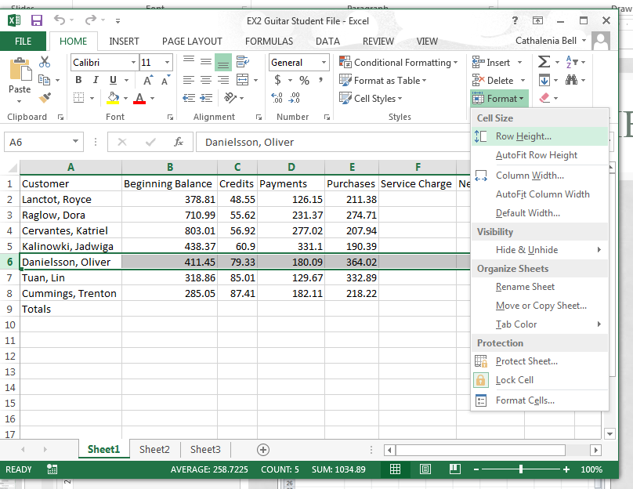
Row Height
A row height may have a value of 0 to 409
This value represents a measurement in points
One (1) point equals approximately 1/72 of an inch
The default row height is 15.0
To change row height, go to the Home Tab, cells group, click Format—Click on Row Height—In the box type the value you want

Slide 20
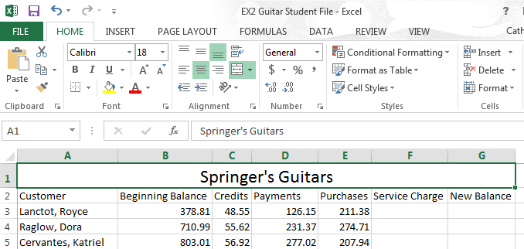
Merge & Center
It is common to center the title, left to right, over the data in the worksheet
The easiest way to do this is to use the Merge and Center option on the Home Tab
Drag through the cells that you
want to merge to highlight them
Click on the Merge and Center
button, Home Ribbon, to merge the
the selected range of cells and
to center align the worksheet title

Slide 21
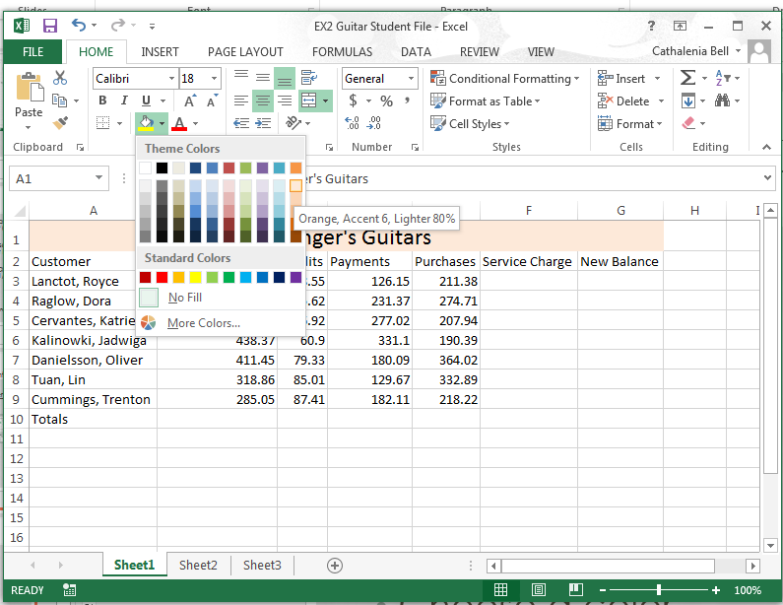
Fill
You can add emphasis to selected cells by changing the Fill color
Click in the active cell, and on the Home Tab, in the Font Group, click the Fill button’s drop down menu
Choose a color from the Fill Color Palette

Slide 22
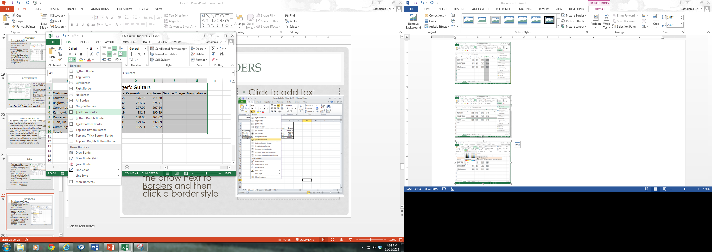
Borders
By using predefined border styles, you can quickly add a border around a cell or ranges of cells
On the worksheet, select the cell or range of cells you want to add a border to
On the Home Tab, in the Font Group, click the arrow next to Borders and then click a border style

Slide 23
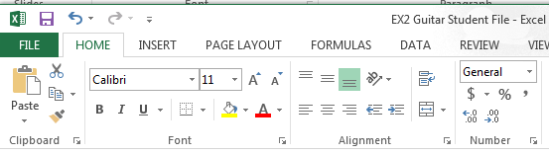
Increase/Decrease Indents
To indent text in a cell, select the cell
On the Home Tab, in the Alignment Group, click repetitively until the text comes to the desired position
For decreasing the indent, select the cell and click the Decrease indent button

Slide 24
Format Painter
Adding formatting to a spreadsheet makes it more attractive and easier for users to find the information they are after
To quickly copy formatting from one part of a sheet to another, use Format Painter

Slide 25
Format Painter
Add all the formatting options you want to at least one cell
Click on that cell to make it active
Click the Format Painter button on the Home Tab, Clipboard Group
Click on the cell that you want to copy the formatting to
If you need to apply the formatting to more than one cell, double-click Format Painter

Slide 26
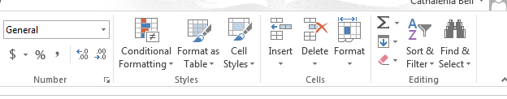
Sort & Filter
Sorting data helps to quickly visualize and understand data better
To sort, select a column of alphanumeric data in a range of cells
On the Home Tab, in the Sort & Filter Group, do one of the following:
  To sort in ascending order, click the A to Z button
  To sort in descending order, click the Z to A button

Slide 27
AutoSum
The AutoSum feature is a shortcut to using Excel’s SUM function
It provides a quick way to add up columns or rows in a spreadsheet

Slide 28
Excel 1

